Slide 1
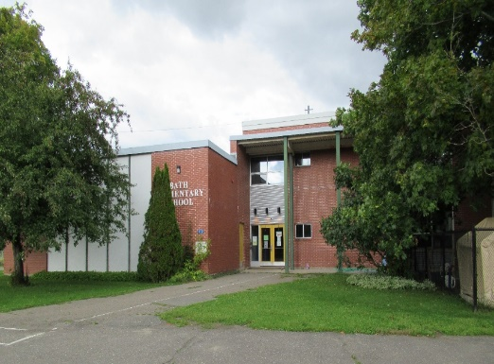
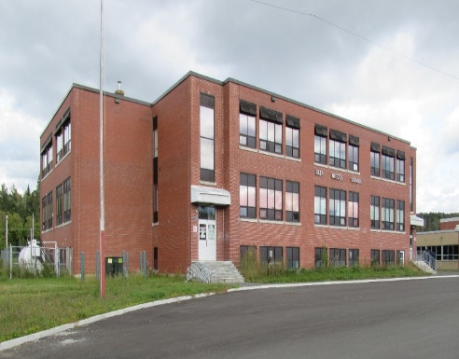
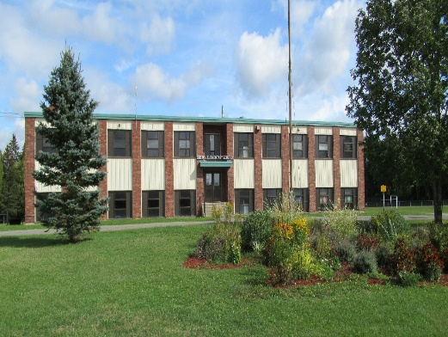
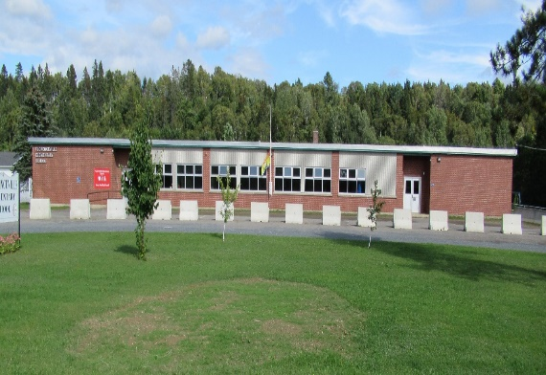
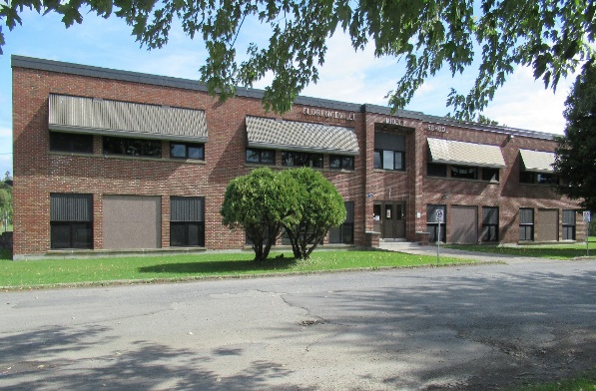
Sustainability Study - Executive Summary
Bristol Elementary
School
Florenceville Elementary
School
Florenceville Middle
School
Bath Community School
May 21, 2020

Slide 2
Executive Summary
Sustainability study for Bath Community School, Bristol Elementary School, Florenceville Elementary School and Florenceville Middle School was initiated by a motion of the District Education Council (DEC) on September 19, 2019, at the regularly scheduled public DEC meeting.
Council, Superintendent and relevant staff coordinated the study that followed the process as outlined in Provincial Policy 409: Multi-year School Infrastructure Planning, Sections 6.4, 6.5, 6.6, and 6.7
Process included three public meetings for each school, formal correspondence with parents, communication with district staff, opportunities to meet with stakeholders, electronic communication, and an overall willingness to share information publicly throughout the study.
Public meetings were attended by DEC and the Councilors also spent time with staff to learn more about each school scenario. The DEC had access to relevant documentation.
Public consultation and communications were respectful throughout the studies and stakeholders from the community were engaged in the process.

Slide 3
Executive Summary
Three possible outcomes were described for each school to those who participated in the study:
o Option 1: Maintain the status-quo at each school
o Option 2: Provide for repairs and investments at each school
o Option 3: Build a new school, closing 3 or 4 schools (Bath Community School, Bristol Elementary School,
Florenceville Elementary School, Florenceville Middle School)
Outside the status quo, recommendations from above would go to the Minister of Education and Early Childhood Development for approval based on procedural fairness. Significant financial investments would need to be approved by the province of New Brunswick.

Slide 4
Public Consultation and Application of Procedural Fairness
Minister of Education and Early Childhood Development was informed of the intention to study Bath Community School, Bristol Elementary School, Florenceville Elementary School and Florenceville Middle School in writing on September 20, 2019.
Superintendent wrote formally to parents of Bath Community School, Bristol Elementary School, Florenceville Elementary School and Florenceville Middle School, eight times between September 2019 and May 2020; the duration of the study. These letters kept the parent population and other stakeholders apprised of the study process.
Each of these documents are available publicly and are a part of the final report (submitted to the Minister if Status Quo is not the outcome).
Documentation (requested and otherwise developed) that provided relevant information about the four schools was shared publicly. A number of these documents are part of the final report.
Documents were used as a basis for study by DEC members and as a catalyst for conversation.

Slide 5
Bath Community School Public Meeting #1
Saturday, November 30, 2019
Approximately 13 members of the community attended.
The Superintendent presented the sustainability study process as well as pertinent information as outlined in Section 6.5.1 of Policy 409.
The presentation, an agenda and meeting notes for the meeting were made public through a district website section dedicated to the study and are included in the final report.

Slide 6
Bath Community School Public Meeting #1
Enrolment as of September 30, 2019 – 128
Enrolment has been declining and it is projected that enrolment will stabilize.
8 homeroom classes and functional capacity is rated at 68%
Built in 1967, the elementary school is safe and has an estimated $577,000 of capital improvement project recommendations on file with our facilities team. Approximately $3.3 million has been invested into the Bath Middle School upgrade project to date, with approximately $4.15 million estimated as needed to finish the project. Phase II of the completion could mean an additional $1 million in costs. Construction sits at 40% completed.
Student: teacher ratio is 11.42:1
Students in French Immersion attend Florenceville Elementary School beginning in Grade 1 and Florenceville Middle School beginning in Grade 6.
Provincial assessment results were presented.
Most students are bused with the minimum distance being 0.1 km and the maximum distance 17.3 km.
Facilities Operational Costs for 2018/2019 - $138,585
Global Budget for 2018/2019 - $27,556
Salaries for 2018/2019 - $1,494,083
Community has presented a strong desire to maintain a K-8 school in the community.
If a K-8 is finished, students remain in the community in an appropriate location. If a new K-8 school is built, students from Bath could be included.
Loss of the community school could impact the economy in the community.

Slide 7
Bath Community School Public Meeting #2
Saturday, January 25, 2020
Approximately 150 members of the community attended.
Leadership from the PSSC and the community presented to the public, district staff and the DEC. There were 8 stakeholder presentations. Presentations touched on the many advantages of Option #2, provide for repairs to Bath Community School.
Presentations, an agenda and meeting notes for the meeting were made public through a district website section dedicated to the study and are included in the final report.

Slide 8
Bristol Elementary School Public Meeting #1
Saturday, November 30, 2019
Approximately 11 members of the community attended.
The Superintendent presented the sustainability study process as well as pertinent information as outlined in Section 6.5.1 of Policy 409.
The presentation, an agenda and meeting notes for the meeting were made public through a district website section dedicated to the study and are included in the final report.

Slide 9
Bristol Elementary School Public Meeting #1
Enrolment as of September 30, 2019 – 90
Enrolment has been declining, with a slight increase in 2019. It is projected that enrolment will continue to decline.
Functional capacity is rated at 44.8%.
6 homeroom classes
Built in 1966, the school is safe and has an estimated $1,019,000 of capital improvement project recommendations.
Student: teacher ratio is 11.68:1
Provincial assessment results were presented.
Students in French Immersion attend Florenceville Elementary School beginning in Grade 1 and Florenceville Middle School beginning in Grade 6.
Most students are bused with the minimum distance being 0.3 km and the maximum distance 37.8 km.
Facilities Operational Costs for 2018/2019 - $46,075
Global Budget for 2018/2019 - $23,365
Salaries for 2018/2019 - $754,563
Municipality and largest community employer has suggested a new K-8 school would be a benefit.
If a new school is built, the school would close.
Municipality suggests that a new school would attract families to the community.

Slide 10
Bristol Elementary School Public Meeting #2
Saturday, January 25, 2020
Approximately 11 members of the community attended.
There were 4 stakeholder presentations. Presentations touched on the advantages of Option #3, a new school.
Presentations, an agenda and meeting notes for the meeting were made public through a district website section dedicated to the study and are included in the final report.

Slide 11
Florenceville Elementary Public Meeting #1
Saturday, October 26, 2019
Approximately 15 members of the community attended.
The Superintendent presented the sustainability study process as well as pertinent information as outlined in Section 6.5.1 of Policy 409.
The presentation, an agenda and meeting notes for the meeting were made public through a district website section dedicated to the study and are included in the final report.

Slide 12
Florenceville Elementary School Public Meeting #1
Enrolment as of September 30, 2019 – 215
Enrolment declined in 2019. It is projected that enrolment will continue to decline.
Functional capacity is rated at 83%.
13 homeroom classes
Built in 1966, the school is safe and has an estimated $1,055,000 of capital improvement project recommendations.
Student: teacher ratio is 12.72:1
Provincial assessment results were presented.
There is French Immersion.
Most students are bused with the minimum distance being 0.9 km and the maximum distance 46 km.
Facilities Operational Costs for 2018/2019 - $82,346
Global Budget for 2018/2019 - $30,812
Salaries for 2018/2019 - $1,571,046
Municipality and largest community employer has suggested a new K-8 school would be a benefit.
If a new school is built, the school would close.
Municipality suggests that a new school would attract families to the community.

Slide 13
Florenceville Elementary Public Meeting #2
Saturday, January 18, 2020
Approximately 14 members of the community attended.
There were three stakeholder presentations. Presentations touched on the advantages of Option #3, a new school.
Presentations, an agenda and meeting notes for the meeting were made public through a district website section dedicated to the study and are included in the final report.

Slide 14
Florenceville Middle Public Meeting #1
Saturday, October 26, 2019
Approximately 15 members of the community attended.
The Superintendent presented the sustainability study process as well as pertinent information as outlined in Section 6.5.1 of Policy 409.
The presentation, an agenda and meeting notes for the meeting were made public through a district website section dedicated to the study and are included in the final report.

Slide 15
Florenceville Middle School Public Meeting #1
Enrolment as of September 30, 2019 – 203
Enrolment has been declining and it is projected that enrolment will continue to decline.
Functional capacity is rated at 42.8%.
10 homeroom classes
Built in 1955, with an addition in 1964, the school is safe and has an estimated $2,358,000 of capital improvement projects recommended.
Student: teacher ratio is 14.00:1
Provincial assessment results were presented.
There is French Immersion.
Most students are bused with the minimum distance being 0.5 km and the maximum distance 41 km.
Facilities Operational Costs for 2018/2019 - $107,426
Global Budget for 2018/2019 - $29,916
Salaries for 2018/2019 - $1,377,211
Municipality and largest community employer has suggested a a new K-8 school would be a benefit.
If a new school is built, the school would close.
Municipality suggests that a new school would attract families to the community.

Slide 16
Florenceville Middle Public Meeting #2
Saturday, January 18, 2020
Approximately 17 members of the community attended.
There were three stakeholder presentations. Presentations touched on the advantages of Option #3, a new school.
Presentations, an agenda and meeting notes for the meeting were made public through a district website section dedicated to the study and are included in the final report.

Slide 17
Executive Summary
In addition to public meetings #1 and public meetings #2, the District Education Council continued the conversations in regular public sessions and scheduled working sessions to further their understanding of the current circumstances with respect to Bath Community, Bristol Elementary, Florenceville Elementary, and Florenceville Middle schools.
Teachers and staff were given the opportunity to provide feedback through a survey and subsequent meeting, if they wished. The DEC Chair attended these meetings.

Slide 18
Public Meeting #3
The third public meeting for all four studies at Carleton North High School on March 19, 2020 was postponed.
The third public meeting for all four studies tentatively scheduled at Carleton North High School on April 8, 2020 was postponed.
The third public meeting for all four studies via Virtual Public DEC Meeting will be streamed to YouTube on May 21, 2020.
This presentation serves as an executive summary and closing comments leading up to discussion by Council and a subsequent motion and vote on each study.
This presentation and an agenda will be included on our district website section dedicated to each study. They will be included in the final report. Official minutes for the meeting and an audio file of the meeting will be made public. The official minutes from this meeting will be sent to the Minister of Education and Early Childhood Development, as required and once approved.
The Chair will write to the Minister with the official motion and indicating status quo if voting for Option #1 or,
The Chair will write to the Minister with the official motion, the recommendation and the accompanying information package if voting for Option #2 (Requesting Investment for Repairs) or Option #3 (Requesting approval for building a new school and combining 3 or 4 schools).
The Superintendent will write to the Parents/Guardians of the students of all four schools with the conclusion of the studies.

